Slide 1
Global Sales Performance Dashboard
Task 4 – Power BI Dashboard
Created by: Vikram Singh Bisht
Tool: Power BI (Corporate Blue Theme)

Slide 2
Objective
• Build an interactive sales performance dashboard
• Analyze orders, revenue, geography, product lines
• Provide business-ready insights for decision-making

Slide 3
Dataset Used
• File: sales_data_sample.csv
• Records: Orders, Sales, Product Line, Geography, Deal Size
• Columns: ORDERDATE, SALES, PRODUCTLINE, COUNTRY, DEALSIZE, STATUS, etc.

Slide 4
KPIs Included
• Total Sales
• Total Orders
• Total Quantity Sold
• Average Order Value
• Top Product Line
• Top Country

Slide 5
Dashboard Layout
dashboard includes:
• KPI Row (Top)
• Slicers: Year, Quarter, Month, Country, Product Line, Deal Size
• Order Status Donut Chart
• Sales Trend Line Chart
• Product Line Sales Analysis
• Quantity Sold by Product Line
• Country-wise Sales
• Deal Size vs Revenue

Slide 6
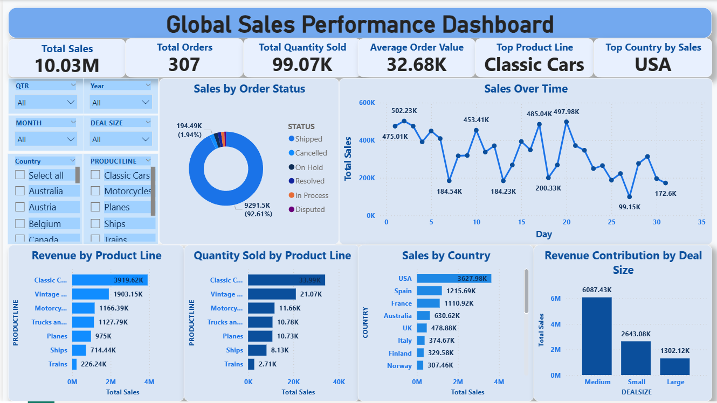
Dashboard Screenshot

Slide 7
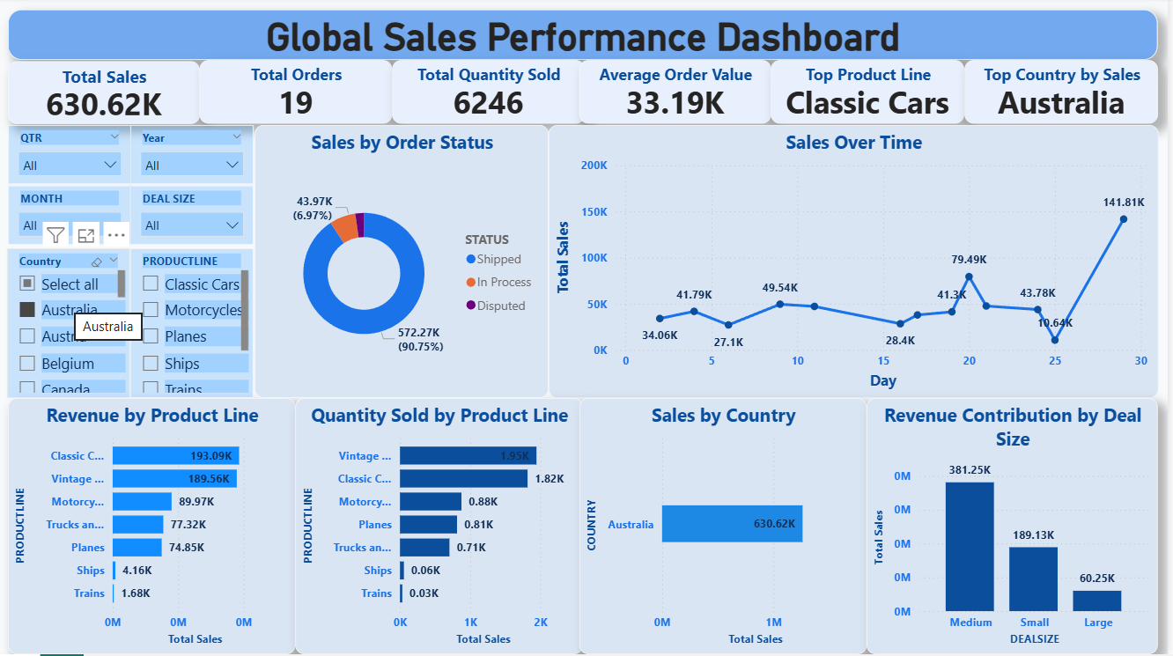
Dashboard Screenshot Using Country Slicer

Slide 8
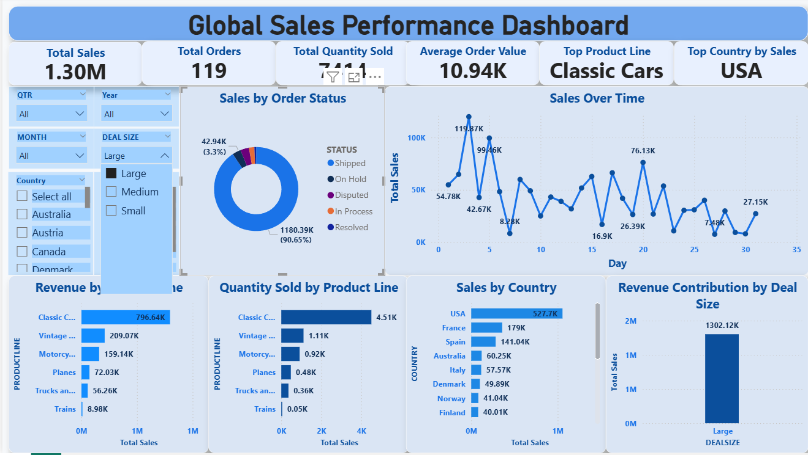
Dashboard Screenshot Using Deal Size Slicer

Slide 9
Insights
• Sales trend shows periodic spikes in key months
• Certain product lines contribute major revenue
• Large deal sizes generate high revenue
• Some countries dominate sales performance

Slide 10
Tools & Theme
• Power BI Desktop
• Corporate Blue Theme
• DAX measures for KPIs
• Slicers for interactivity

Slide 11
Conclusion
• Dashboard provides actionable insights
• Supports decision-making for sales & product strategy
• Fully interactive and user-friendly design

